Slide 1
NY Real Estate Investment
Presented by,
Shelly, Shubhra, Rachel, Kevin

Slide 2
NYC Real Estate
Objective - Investing in Real Estate in NYC Boroughs as an investment strategy for both Rental and Sales properties
Manhattan, Brooklyn, Queens, Bronx, Staten Island
Data Source
Attom API - Historical Sales Data
NYC Open Source - Data - GeoMapping, Zip to Neighborhood Mapping
Zillow - Historical Rent Data
***Data is pre COVID****
https://github.com/ShakedRj/project_01_fintech

Slide 3
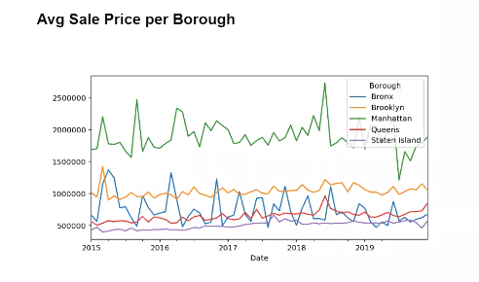
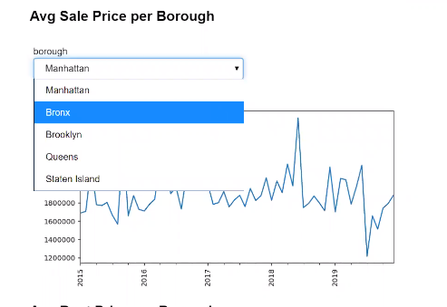

Slide 4
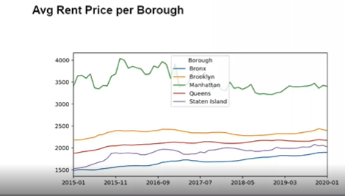
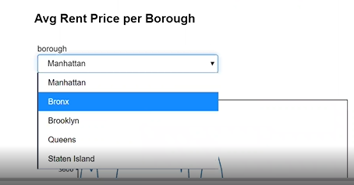

Slide 5
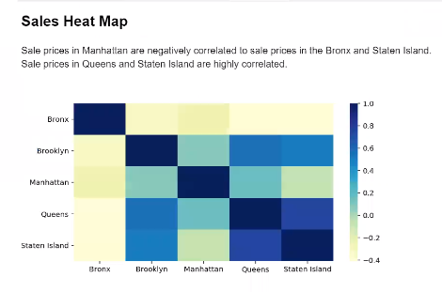

Slide 6
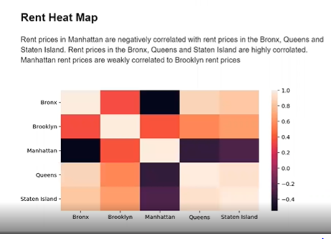

Slide 7
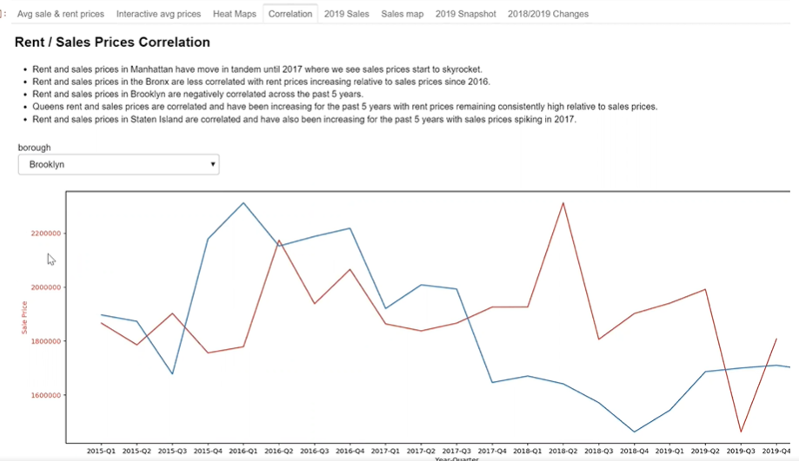

Slide 8
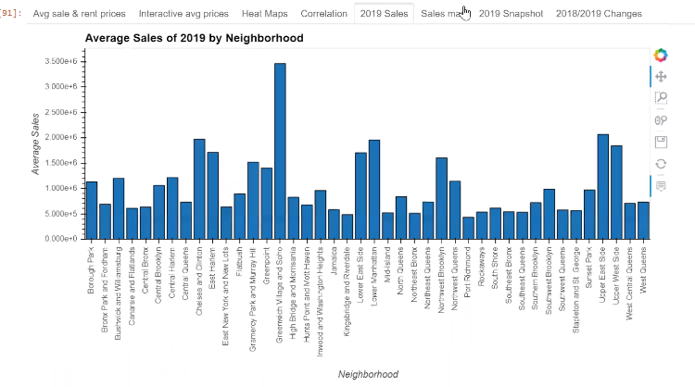

Slide 9
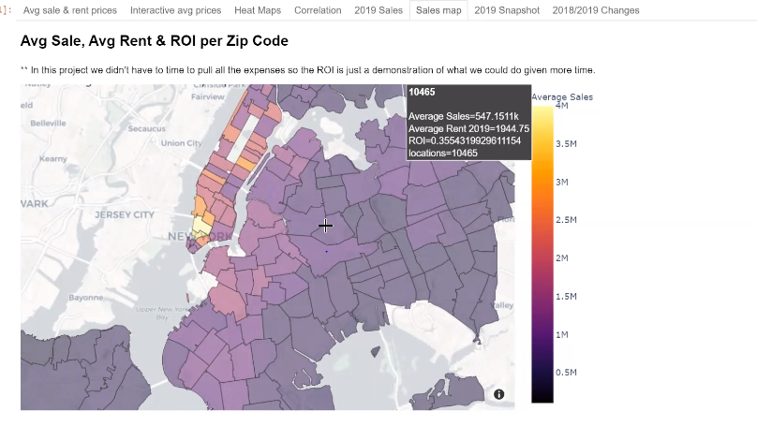
Capitalization rate, also known as cap rate or ROI, refers to a property’s net income as a percentage of its market value. For the purposes of this calculation, the purchase price of the property is often used as its market value, especially if it was acquired within the past few years.

Slide 10
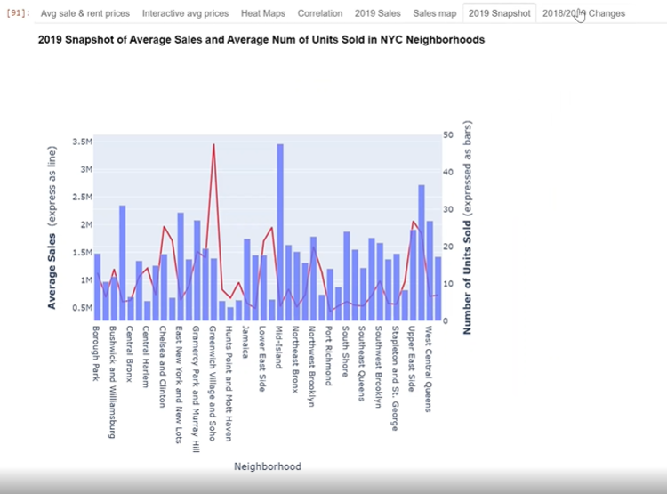
Cap rate can be useful for a few reasons. For starters, it could be an apples-to-apples way to compare potential rental properties that may have different financing structures, since it doesn’t take debt repayment into account. For example, if your lender wants a 15% down payment on a single-family property and a 25% down payment for a duplex, using the expected cap rate can help you determine which is the better deal relative to its rental income potential.

Slide 11
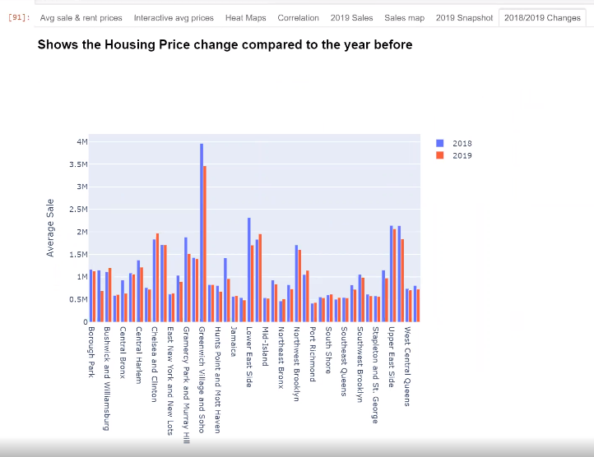

Slide 12
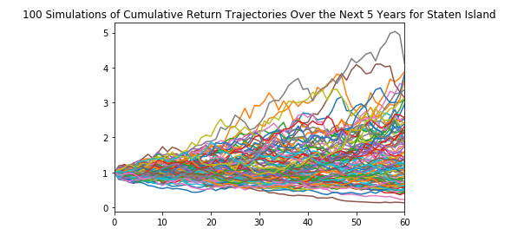
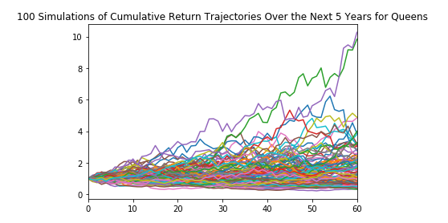
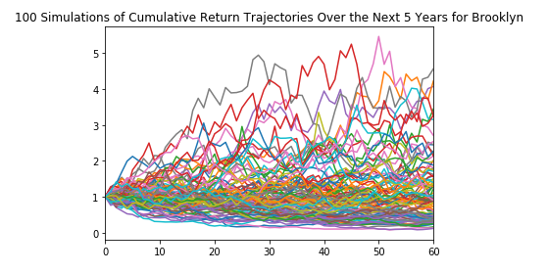
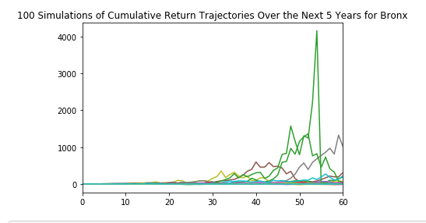
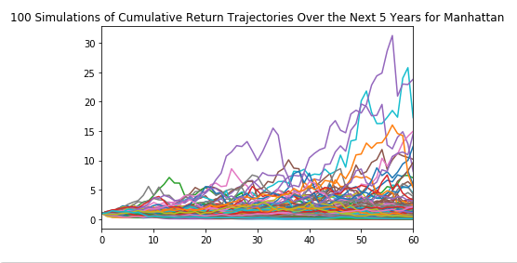
Monte Carlo – Sales Next 5yrs

Slide 13
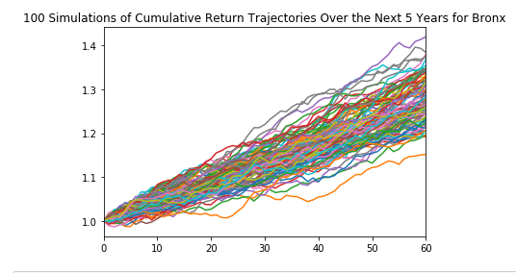
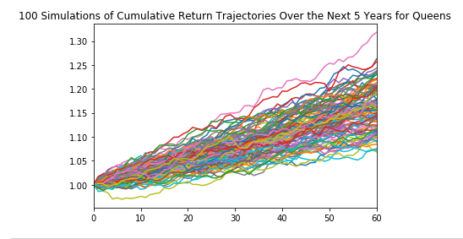
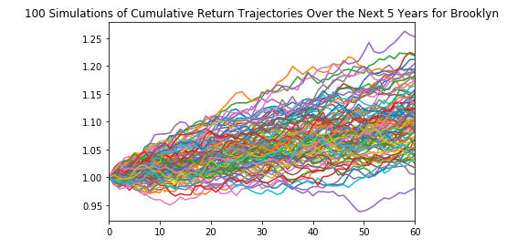
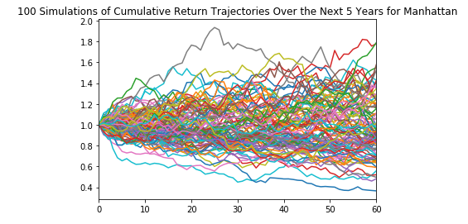
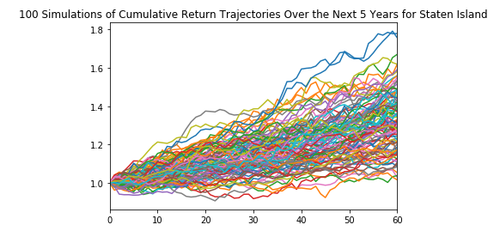
Monte Carlo – Rental Next 5yrs

Slide 14
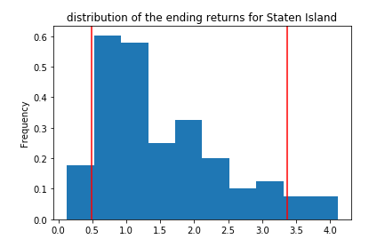
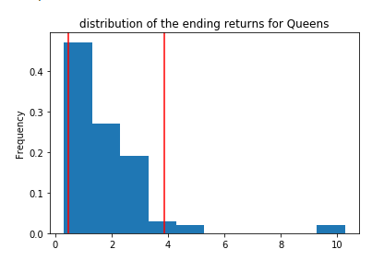
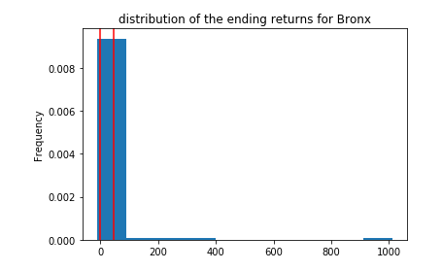
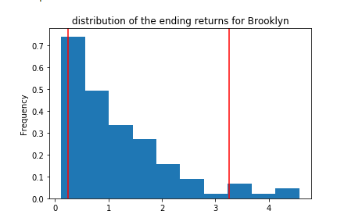
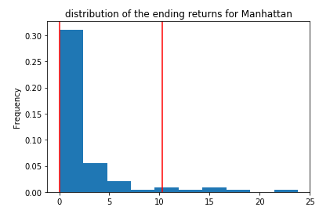
Confidence Interval for Sales

Slide 15
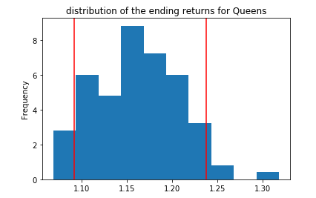
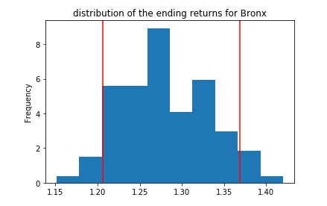
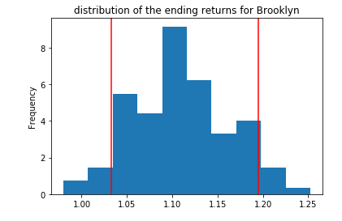
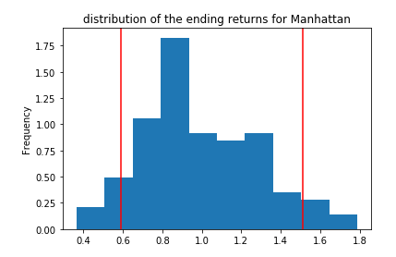
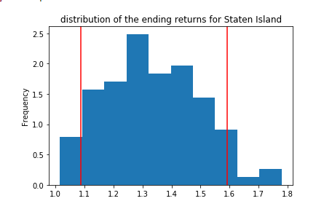
Confidence Interval for Rental

Slide 16
Q&A

